Slide 1
Using the Set Operators

Slide 2


Slide 3
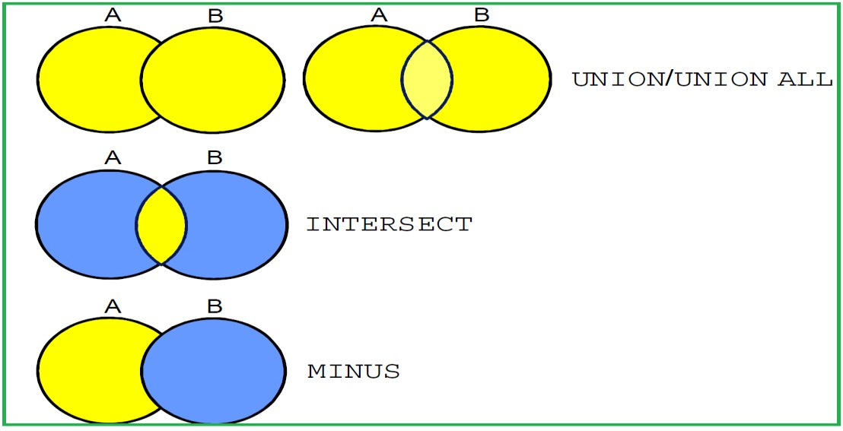

Slide 4
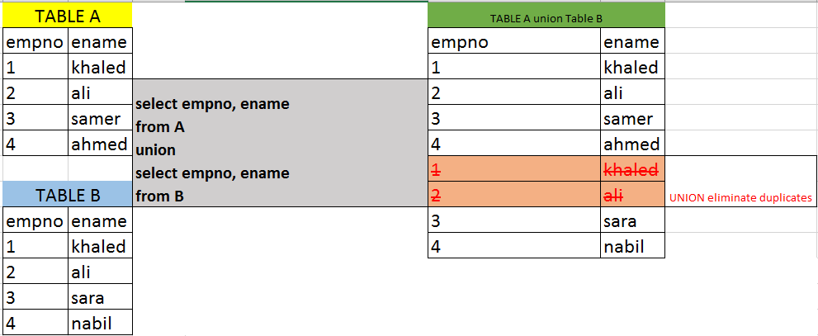
Union

Slide 5
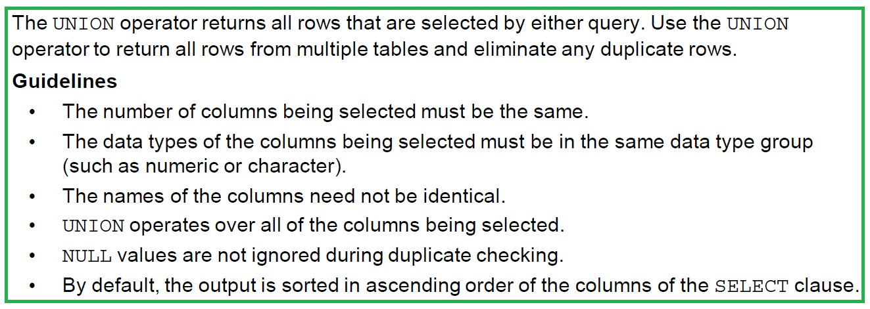
Union

Slide 6
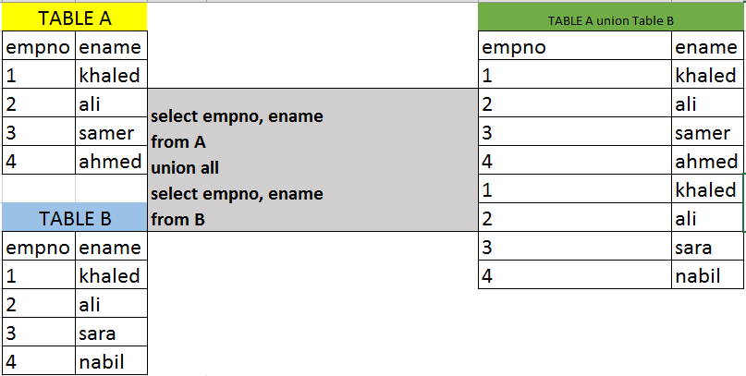
Union All

Slide 7

Union All

Slide 8
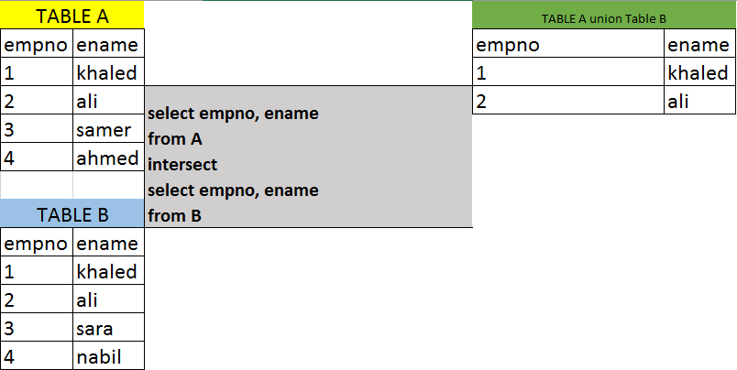
Intersect

Slide 9

Intersect

Slide 10
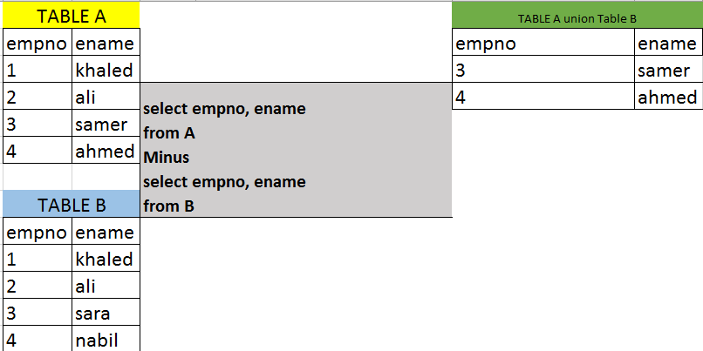
Minus

Slide 11

Minus

Slide 12
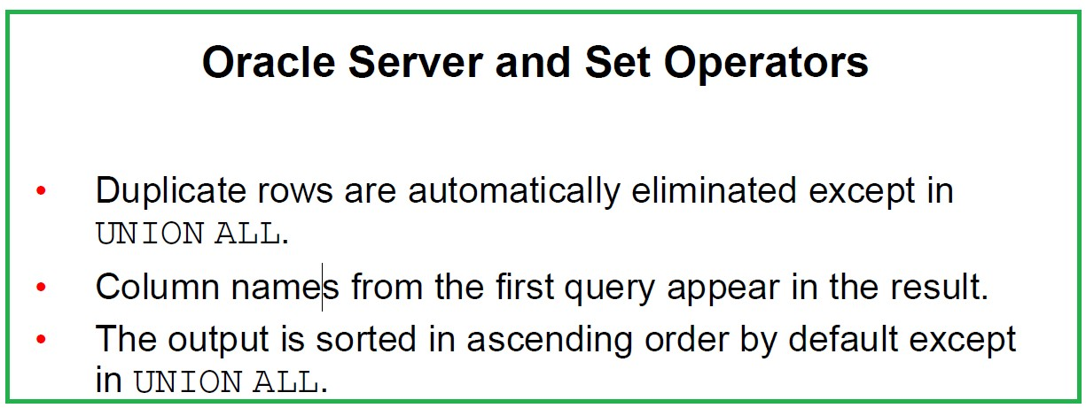

Slide 13
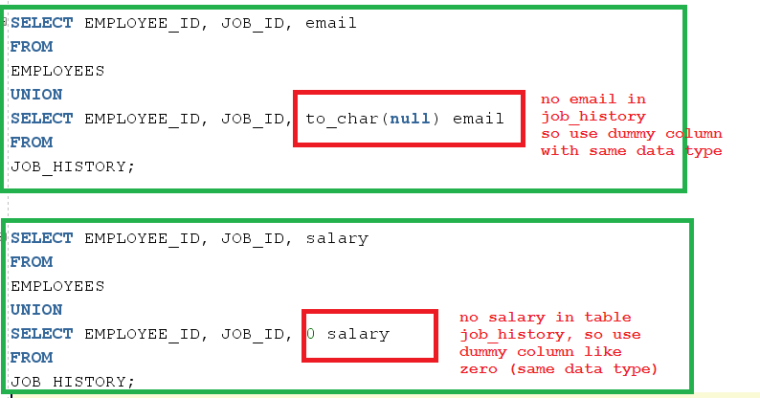
Matching the Select statement

Slide 14
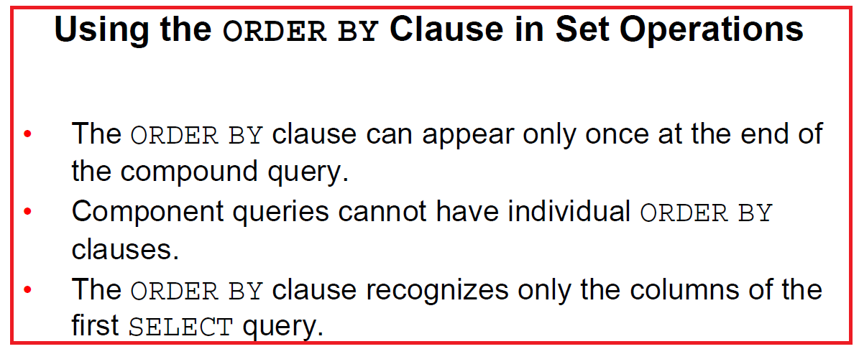

Slide 15
Thank You
Prepared By :Khaled AlKhudari
10

